Slide 2
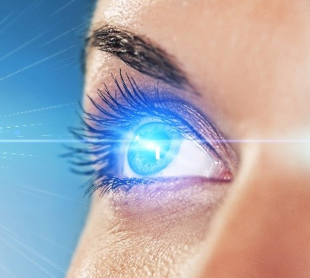
Sermon on the Mount
Matthew 5-7
“The Lamp Of The Body”
Matthew 6:22,23

Slide 3
Sermon
on
the Mount
Direction In Life Is So Important
Matthew 6:19-21
“Do not lay up for yourselves treasures on earth…”
“lay up for yourselves treasures in heaven…”
  V. 24 “No one can serve two masters; for either he will hate the one and love the other, or else he will be loyal to the one and despise the other. You cannot serve God and mammon."
  The Direction or Affection of the Heart

Slide 4
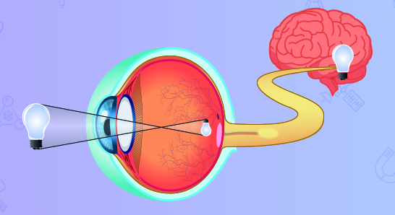
THE LAMP OF THE BODY

Slide 5
Sermon
on
the Mount
Matthew 6:22-23
THE ‘SINGLE EYE’ OF FAITH
“not complex,…healthy, perfect”
Simplicity is the idea – Not stupidity
Prudence - Knowing how to deal with others in circumstances of life
Views world in right perspective and if focused on right things
Life with one, single, uncomplicated purpose

Slide 6
Sermon
on
the Mount
Matthew 6:22-23
THE SINGLE EYE FULL OF LIGHT = WHOLE BODY FULL OF LIGHT
  “For me to live is Christ…” Philippians 1:21
  “I have learned…to be content…” Philippians 4:11
  “God is light…” 1 John 1:5
Ephesians 1:18 “eyes of your understanding be enlightened;”

Slide 7
Sermon
on
the Mount
Matthew 6:22-23
THE DARKNESS OF THE EVIL EYE V.22
  Sight darkened, blinded, distorted, misleading, misguiding
  Eye of our minds become centered on evil
  Mark 6:22 “an evil eye…”
  John 3:19 “love darkness rather than light”
  No longer see GOOD – the direction to go!

Slide 8

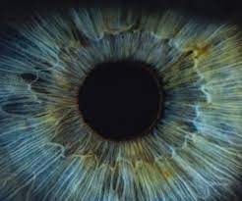
Sermon
on
the Mount
Matthew 6:22-23
HOW GREAT IS THAT DARKNESS

Slide 9

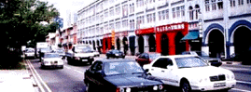


Sermon
on
the Mount
Matthew 6:22-23
HOW GREAT IS THAT DARKNESS

Slide 10
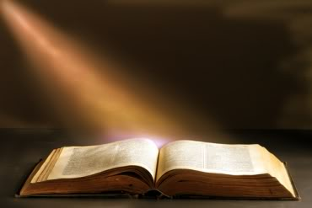
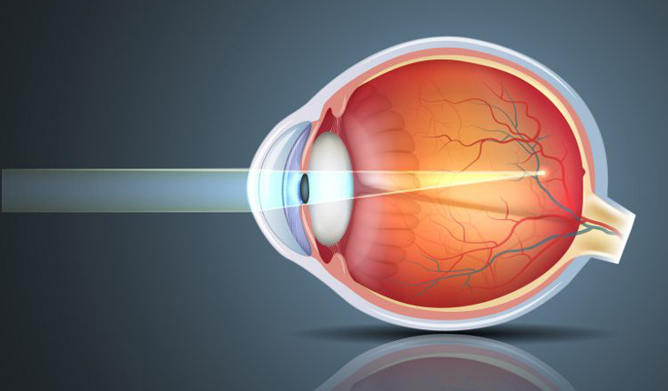
Sermon
on
the Mount
Matthew 6:22-23
HOW GREAT IS THAT DARKNESS
  Evil is perceived to be good!
  How much darkness are we in when we can no longer tell the difference between RIGHT & WRONG?

Slide 11
Sermon
on
the Mount
Matthew 6:22-23
1 Thessalonians 5:5,6
"You are all sons of light and sons of the day. We are not of the night nor of darkness. "Therefore let us not sleep, as others do, but let us watch and be sober.”
Hebrews 5:14 “by reason of use have their senses exercised to discern both good and evil”

